Slide 1
Extracting
Music Notes
From Melody
Tal Sagie

Slide 2
Objectives
The main purpose of this project is to extract musical notes from audio or tune.
In this presentation, I will attempt to discuss the research I conducted and the challenges I encountered when attempting to relate classroom materials to the field of music from theory to practice.

Slide 3
Table of contents
01
Overview
03
Findings
02
The Procedure
04
Conclusion
Main goals and faces
While working on the project, I came across a few things that I thought were fascinating.
So how we going to do it?
final thoughts

Slide 4
01
Overview

Slide 5
Introduction
Songs play an important role in our daily lives. A song is made up of two parts: vocals and background music.
Where the vocalist's voice qualities are determined by the singer, and background music is composed of a variety of musical instruments such as piano, guitar, drums, and so on. The ability to extract a song's characteristics is becoming increasingly useful for a variety of purposes, including learning, teaching, and composing. This project takes a song as input and extracts the features before detecting and identifying the notes, each of which has a length.
The song is first recorded, then the qualities are identified using digital signal processing techniques.

Slide 6
Introduction
For a trained listener, extracting meaningful musical information from a live or recorded performance is very simple, but for a learner or machine, it is far more difficult. It would be nice to collect this information in a speedy, error-free, automated manner for a variety of practical applications. This project focuses on the development of a software system that takes a digitized waveform representing an acoustic music signal as input and attempts to extract the notes from the signal in order to generate a musical score. Event detection, or precisely where within the signal the individual notes actually begin and end, and pitch extraction, or the identification of the pitches being played in each interval, are both part of this signal processing algorithm.

Slide 7
—Bob Marley
“One good thing about music, when it hits you, you feel no pain.”

Slide 8
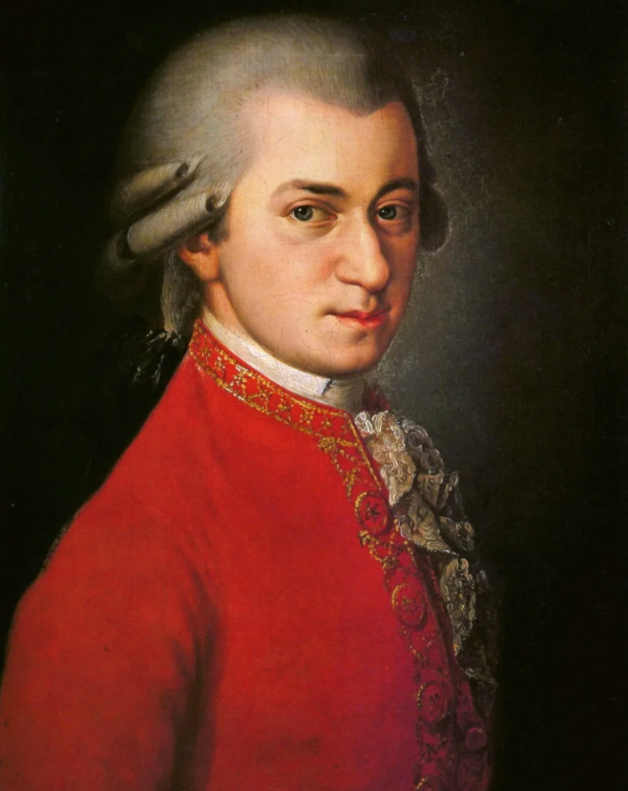
Fun Fact
In 2016, Mozart sold more CDs than Beyonce
In fact, Mozart sold the most CDs in 2016, beating out Adele, Drake, and Beyoncé, even though all of those artists had Grammy-winning hits that year.
So, how'd an 18th-century composer sell more than pop music's greatest names? Well, in October 2016, the Universal Music Group released a box set commemorating the 225th anniversary of Mozart's death. Each disc included in the box set counted as one CD sold, and each set contained 200 discs. Throw in the proliferation of streaming—which has significantly dampened CD sales—and voila. Plus, the box set itself flew off shelves: As of this writing, there are only four remaining on Amazon ($686).

Slide 9

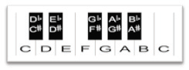
Musical Notes
Signal frequencies between 20 and 20 kHz are audible to humans. Some parts of this vast spectrum are linked with the piano. The ranges of different pianos are diverse. As illustrated in picture below, each piano tone has a unique fundamental frequency that is represented by a note such as C, D, etc. The second C is 12 half steps apart from the first and has double the fundamental frequency. As a result, this section (from one C to the next C) is referred to as an octave. C1, C2, and so on distinguish distinct octaves.

Slide 10
Musical Notes
Western music divides the octave into twelve notes. For historical reasons, there are seven "natural" sounds, and more
Five sounds that are considered as a change of the natural sounds.
The names of the sounds in most of the world are: דו, רֶה, מִי, פַה, סוֹל, לַה, סִי.
In the United States, however, the notation C, D, E, F, G, A ,B is used
Respectively.
the fifth A (called A₄), tuned to 440 Hz (referred to as A440).Since every octave is made of twelve steps and since a jump of one octave doubles the frequency (for example, the fifth A is 440 Hz and the higher octave A is 880 Hz), each successive pitch is derived by multiplying (ascending) or dividing (descending) the frequency of the previous pitch by the twelfth root of two (approximately 1.059463).For example, to get the frequency a semitone up from A₄ (A♯₄), multiply 440 by the twelfth root of two. To go from A₄ to B₄ (up a whole tone, or two semitones), multiply 440 twice by the twelfth root of two (or just by the sixth root of two, approximately 1.122462). To go from A₄ to C₅ (which is a minor third), multiply 440 three times by the twelfth root of two, (or just by the fourth root of two, approximately 1.189207).

Slide 11
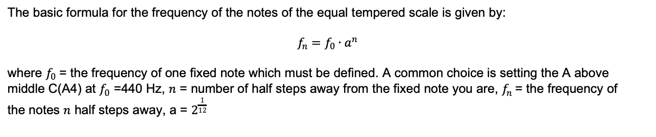
Equation For the Frequency Table
The basic formula for the frequency of the notes of the equal tempered scale is given by:
$$f_{n}=f_{0}∙a^{n}$$
where $f_{0}$= the frequency of one fixed note which must be defined. A common choice is setting the A above
middle C(A4) at $f_{0}$ =440 Hz, $n$ = number of half steps away from the fixed note you are, $f_{n}$= the frequency of
the notes $n$ half steps away, a = $2^{\frac{1}{12}}$

Slide 12
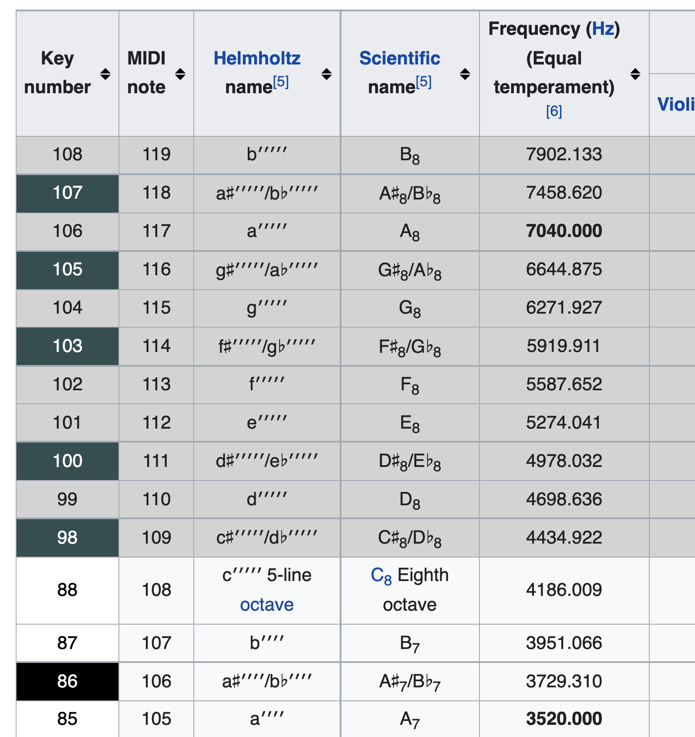
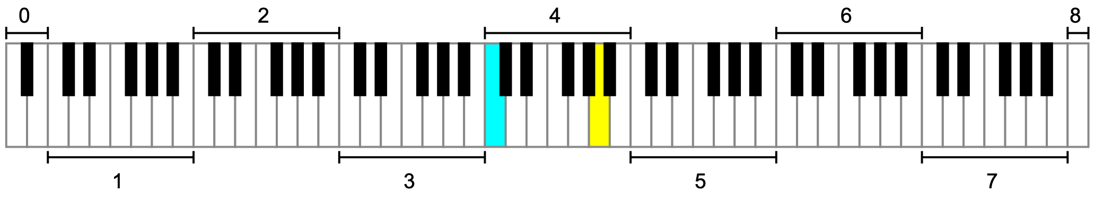
values in bold are exact on an ideal piano. Keys shaded gray are rare and only appear on extended pianos. The normally included 88 keys have been numbered 1–88, with the extra low keys numbered 89–97 and the extra high keys numbered 98–108
This list of frequencies is for a theoretically ideal piano. On an actual piano the ratio between semitones is slightly larger, especially at the high and low ends, where string stiffness causes inharmonicity, i.e., the tendency for the harmonic makeup of each note to run sharp.
An 88-key piano, with the octaves numbered and Middle C (C4,cyan) and A440 (A4,yellow) highlighted

Slide 13
02
The Procedure

Slide 14
Methodology
Detection
Averaging
Thresholding
Identification
Zero Padding
FFT
Input Song
Notes

Slide 15
03
Findings

Slide 16
Sampling
When your voice (or a musical instrument) produces a sound wave, it's an analog wave of changing air pressure. A computer, on the other hand, must record discrete values at discrete time intervals in order to store a sound wave. Sampling is the method of recording discrete time values, and Quantizing is the process of capturing discrete pressures. The normal sampling frequency in recording studios is 48 kHz, while CDs have a rate of 44.1 kHz. Signals should be sampled twice as fast as the signal's highest frequency. Humans can hear frequencies between 20 and 20,000 Hz, which explains why sampling frequencies in the 40 kHz range are so popular.
In Short:
Sampling rate or sampling frequency defines the number of samples per second (or per other unit) taken from a continuous signal to make a discrete or digital signal.
In addition , we are going to examine a stereo audio file which means it has 2 channels,
Music that is mixed for headphone listening is saved as a file with two channels - one sent to the left ear, one sent to the right, while surround-sound movie audio is often mixed for 6 channels.

Slide 17
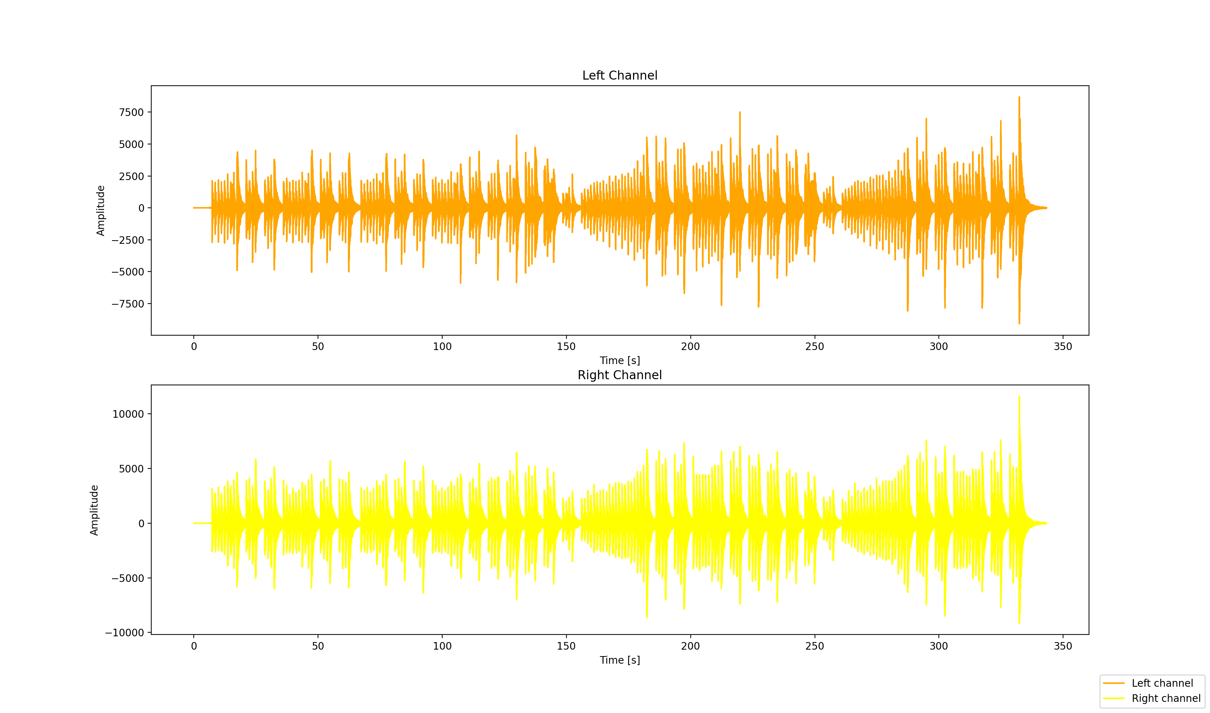
In the figure above we can see the graphs of the audio file in left and right channel
We can see the change of the Amplitude against Time (taken in seconde)
Amplitude: of a periodic variable is a measure of its change in a single period

Slide 18
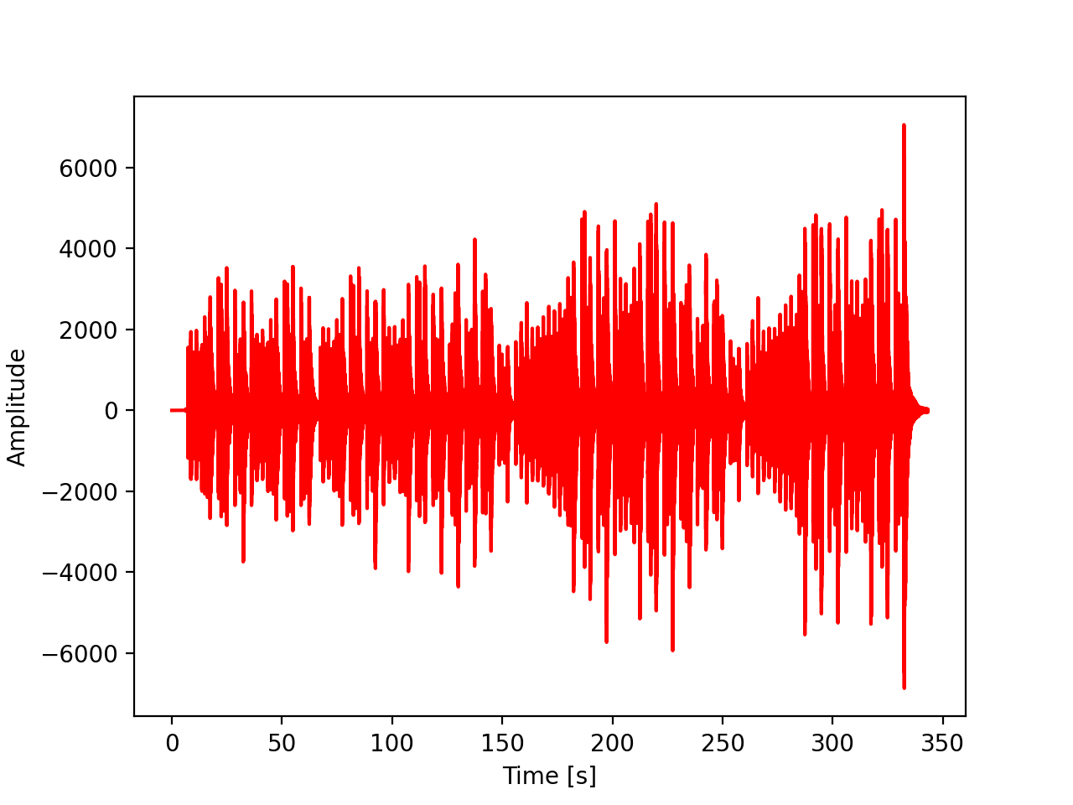
Converting Stereo to Mono
The song after converting it to Mono
I took the avg of each value from Left Channel and Right Channgel

Slide 19
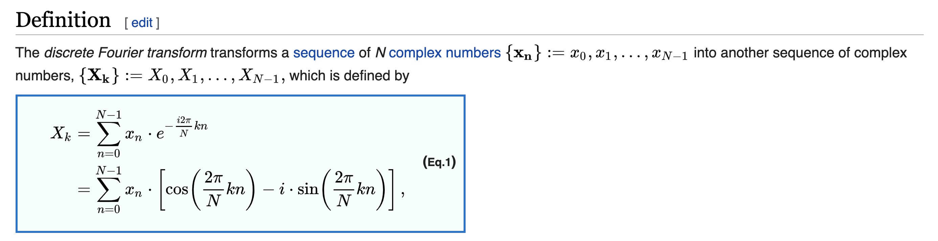
Frequency and Fourier Transforms
Right now what we have is the sum of different frequencies and we want to decompose them
A Fourier transform is used to decompose a complex signal, such as a musical tone, into its component sinusoids. Many integrals and a continuous signal are used in this method. We need to utilize the Discrete Fourier Transform instead of the Continuous Fourier Transform to conduct a Fourier transform on a sampled (rather than continuous) data.
Taken from Wikipedia

Slide 20
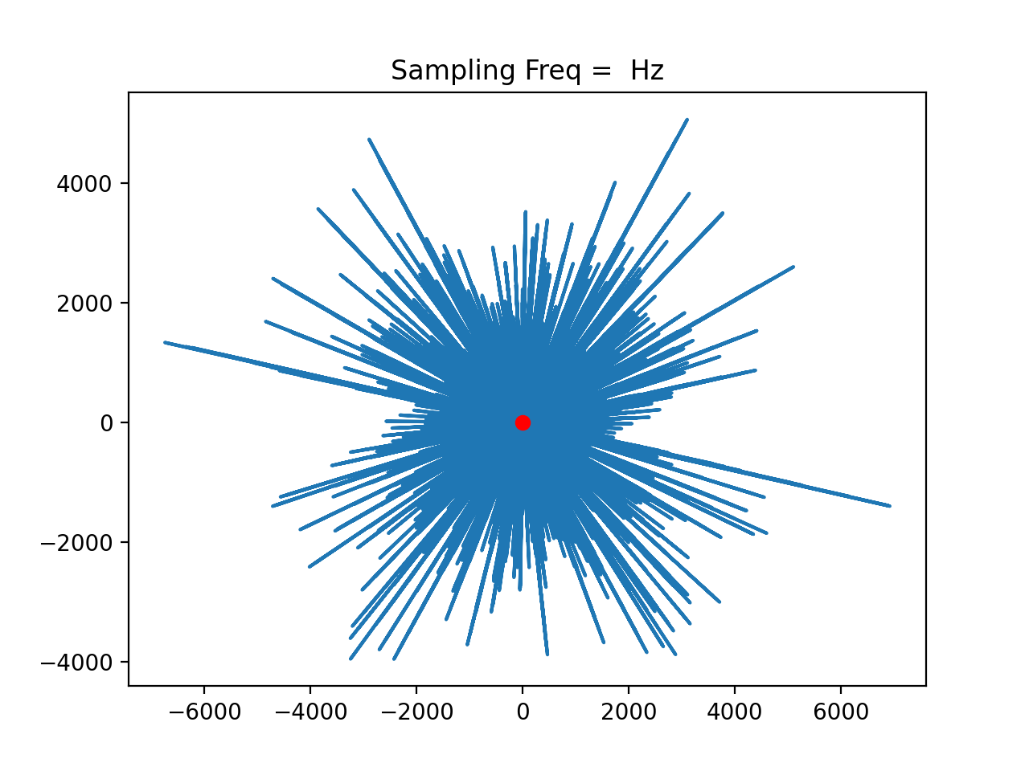
The Idea-FFT
Just to summaries the idea when talking on FFT we need to try warping the input signal graph for a number of sampling frequencies and then by keeping the track of the x-coordinate of the center of mass, considering the warped graph as a piece made of metal wire, we can estimate the frequencies present in the input signal.
plot :I’ve taken the signal and wrapped it around a circle to demonstrate the main idea of the FFT .Imagine a little rotating vector where each point in time its length is equal to the height of our graph at that time. So, high point of the signal corresponds to greater distance from the origin
The Red dot denotes the Center of Mass of the graph.

Slide 21
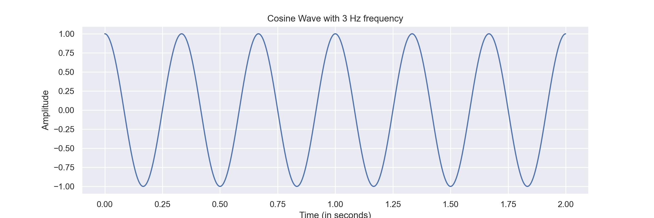





Lets try and demonstraite this idea with lower numbers so I can compute this and plot some graphs , let us take a 3Hz wave for example and demonstrate
Now, Imagine a little rotating vector where each point in time its length is equal to the height of our graph at that time. So, high point of the signal corresponds to greater distance from the origin.
Evrey vector like that represents a point in a circle. When we take the x and y coordinates .

Slide 22
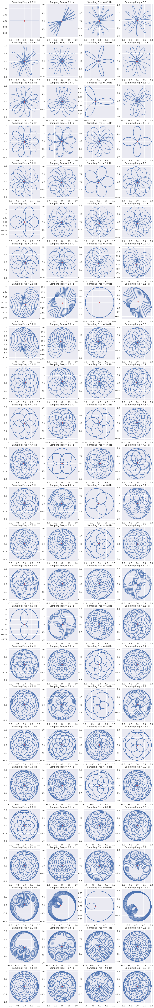












Now we can make this process(of covering the signal as a circle) in a few ways lets say for instance that I would like to make 0.5 cycle/second the vector would rotate at half a cycle per second then its like saying 1 full cycle every 2 sec then we will round our circle (see pic below). But, we can adjust this speed however we want lets say for instance we want to make it 1.6 cycle/second then our graph will look different like in the examples on the left.Lets call this speed Winding freq.

Slide 23
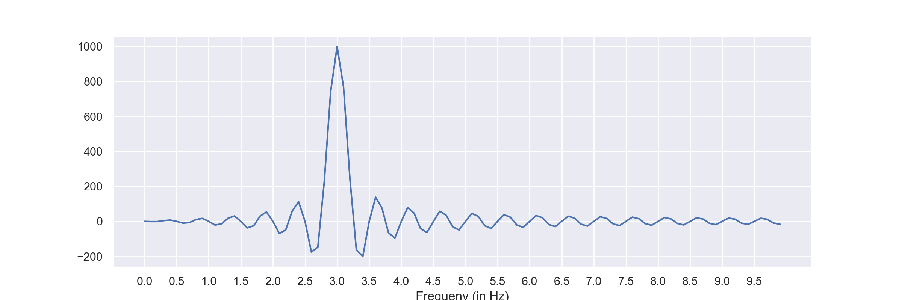
Now if we look at the graph of 3 cycle/sec
We get a perfect circle, lets consider the little square dot as the center of mass
if we think of that circle as a wire when we change Winding freq.
This little dot wobble around a little bit . When the Winding freq from before is the same as the freq of our signal in this case 3 cycle/sec==3Hz then our center of mass is
Unusally to the right as we can see in the to the left picture its in 0.50 as for other graphs (its usually around 0) the center of mass is about the same
This center of mass is calculated by taking the avg of point x and y of each sample of Winding freq we made.
Now lets draw a plot that keeps track of where this center of mass located in each
Winding freq

Slide 24
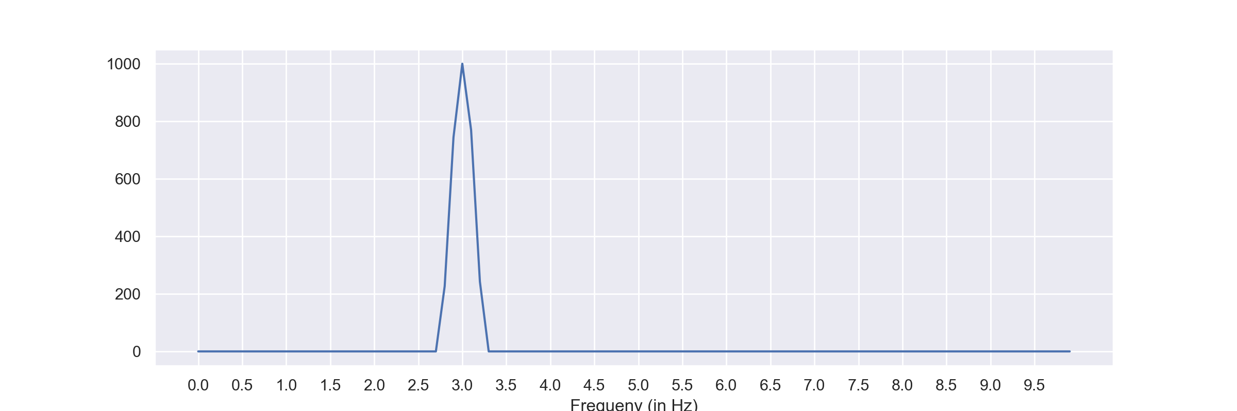
For clear estimation of Frequencies present, we need to smoothen the graph. Below is the smoothened version of the graph, with a clear peak near around 3 Hz.
The think that makes this technique
So delightful is the idea of how it enable
us to take a signal consisting of multiple freq
And pick out what they are
Lets take for instance 2Hz+3Hz
If we make the same procedure we will get
A spike at point 2 and 3

Slide 25

Averaging
Because a song has a high number of samples and many swings, the first step is averaging, in which the average is found for every 20 samples and the value is allocated to the first sample, and the average value is assigned to the second sample for the next 20 samples. This will not only minimize the quantity of samples, but it will also improve the quality of the samples and also the swings will be removed.
Effect of Averaging
When the signal decays slowly, the averaged signal becomes more dense. However, in the case of fast decaying signals, the averaged signal represents the original signal's envelopd)=in sound and music, an envelope describes how a sound changes over time)

Slide 26
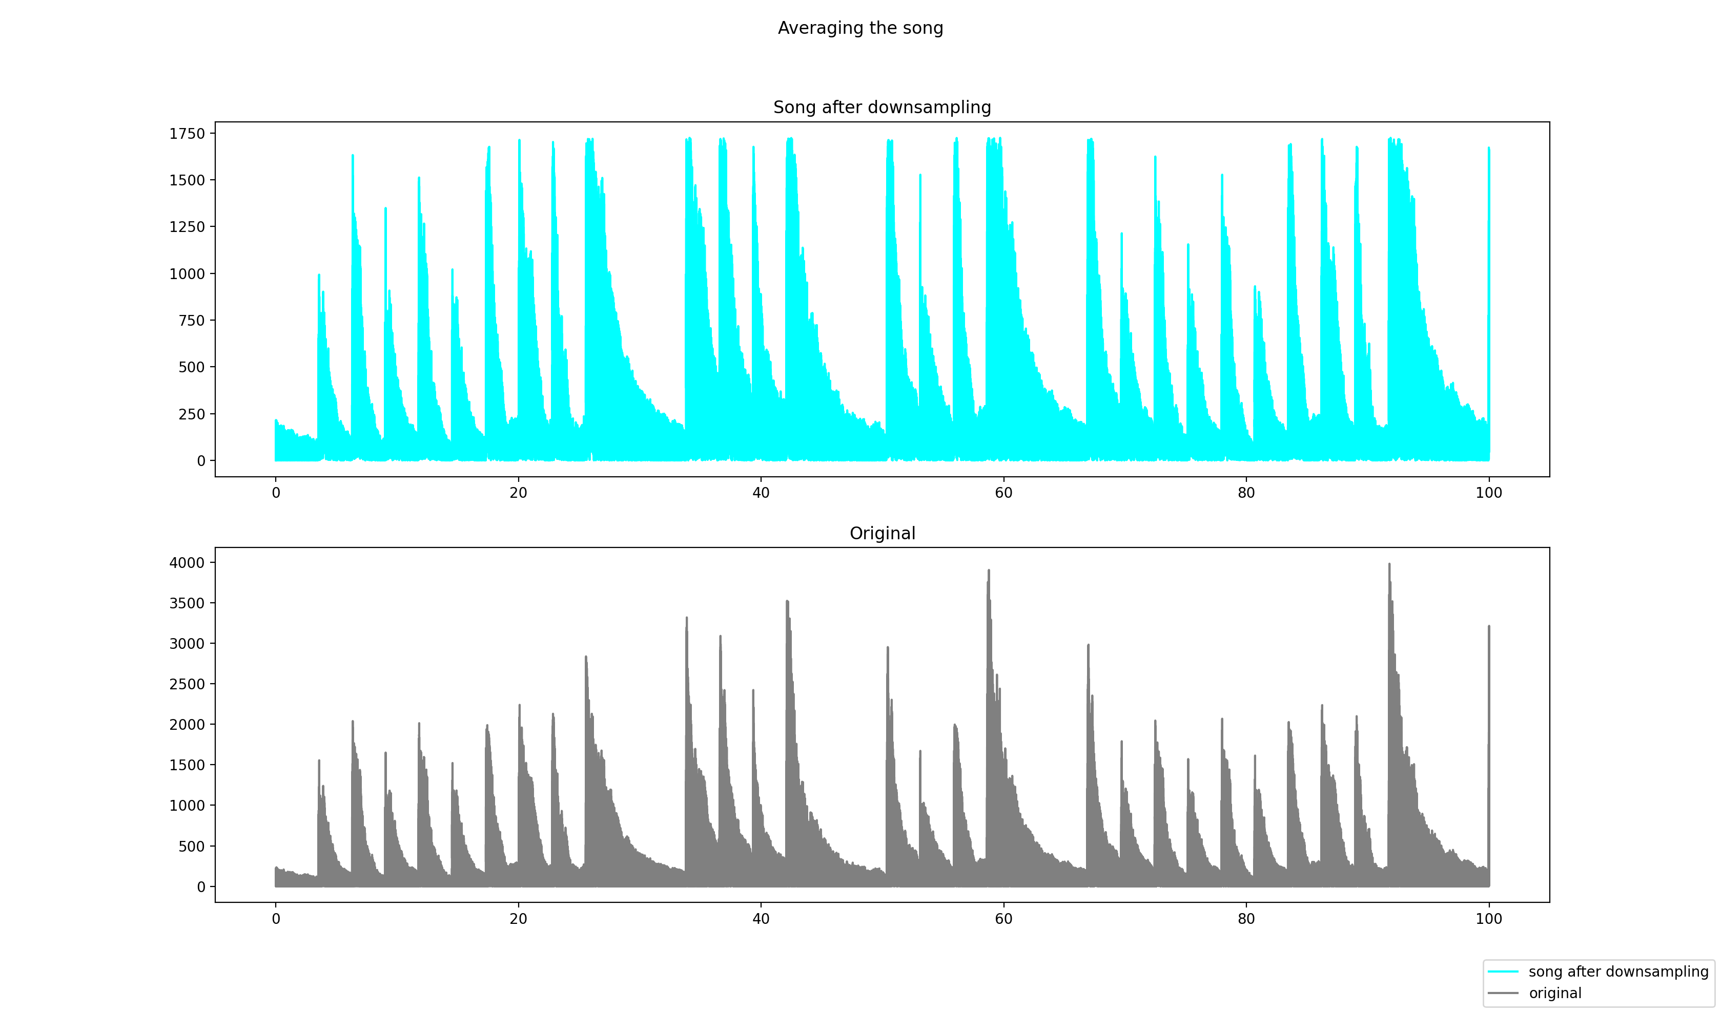

Slide 27
Thresholding
Constant Thresholding : After averaging we need to detect the peaks from the averaged signal. As the name suggests, in constant thresholding one optimum value is decided for which we are able to get maximum number of peaks.
Adaptive Thresholding : There are the possibilities when we take some constant threshold value, for some notes it may be higher than the maximum value of the note and for some notes it is low enough such that two peaks of the note get merged and only one peak (one note) could be detected. To overcome this problem the concept of adaptive thresholding came into picture.
But, even in adaptive thresholding one problem is, when there is long silence between two notes, the threshold value for the silence will be very low that supposed to be discarded

Slide 28
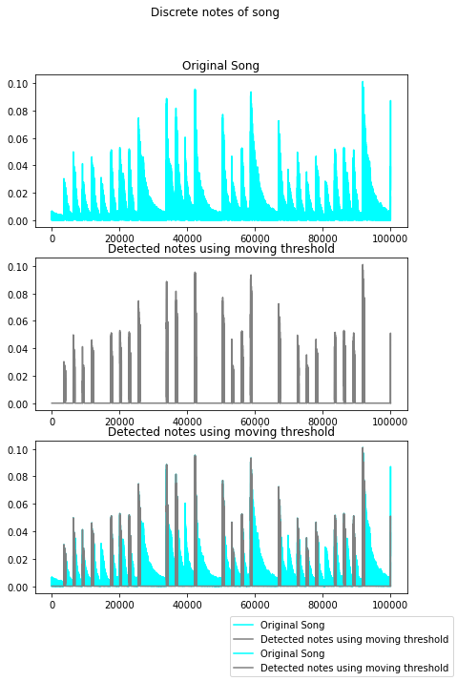
I used: thresh = 5*median(abs(y_avg(max(1,i-5000):i)))

Slide 29
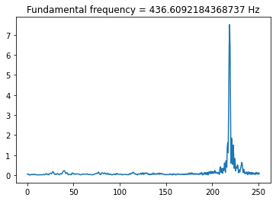
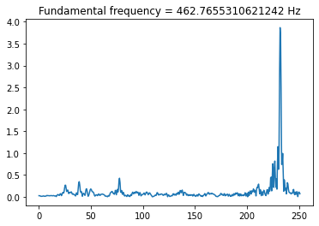
Width Selection for Finding instant and the result
Once the thresholding is done, our aim is to detect the occurrences of the peaks from the signal we get
after thresholding.
The width of the window contains all zeroes is selected on the basis of worst case scenario. For our
song it is found as 20, so the width was chosen as 20 for safety. The worst case depends on the speed for a given sampling frequency. For slow songs it is more and for faster one it is less.
After this process we pad with zero and running FFT, then we take the index of the max element we found on FFT on abs values, these is our freq ,by using the table of frequencies from Wiki we switch the freq with the corresponding note by taking the natural log of this freq then multiply by constant and finally , we get the note.

Slide 30
04
Conclusions

Slide 31
Conclusions
The frequencies of a piano tune are recognized in this project, and the matching notes are identified. This approach for note identification utilized here is optimized although not perfect. We can acquire the desired outcomes with the time duration of each note by altering factors such as threshold values and width. We used FFT and learned his power in this project which until today he is used in the industry .

Slide 32
Hope you Enjopyed!

